Slide 1

CARBON GECKO

Slide 2
SOCIAL MEDIA
CONSUMPTION

Slide 3






SOCIAL MEDIA
CONSUMPTION

Slide 4

SERVERS

Slide 5

LOGIN
REFRESH
UPLOAD
REQUESTS
SERVERS

Slide 6
LOGIN
REFRESH
UPLOAD
PROCESSING UNITS
COMPUTA-TIONAL TIME
REQUESTS
SERVERS
DEMANDS

Slide 7
LOGIN
REFRESH
UPLOAD
REQUESTS
A LOT OF SERVERS

Slide 8
NOT ENTIRELY POWERED WITH GREEN ENERGY
CARBON EMISSION
ISSUES
A LOT OF SERVERS

Slide 9
Carbon Impact in gEqCO2/10min
Daily Time Spent in Minutes
Carbon Emission in geqco2/day
100
75
50
25
0
LinkedIn
YouTube
Pinterest
Twitter
Facebook
Snapchat
Instagram
Reddit
TikTok
HTTPS://WWW.BROADBANDSEARCH.NET/BLOG/AVERAGE-DAILY-TIME-ON-SOCIAL-MEDIA
HTTPS://GREENSPECTOR.COM/EN/SOCIAL-MEDIA-2021/
HTTPS://WWW.BUSINESSDIT.COM/AVERAGE-TIME-SPENT-ON-REDDIT/

Slide 10
ANNUALLY
92 KG CO2
PER PERSON
INCLUDES ONLY CERTAIN SOCIAL MEDIA PLATFORMS

Slide 11
ANNUALLY
820 KM BY CAR
PER PERSON
HTTPS://WWW.EPA.GOV/ENERGY/GREENHOUSE-GAS-EQUIVALENCIES-CALCULATOR#RESULTS
HTTPS://GREENSPECTOR.COM/EN/SOCIAL-MEDIA-2021/

Slide 12
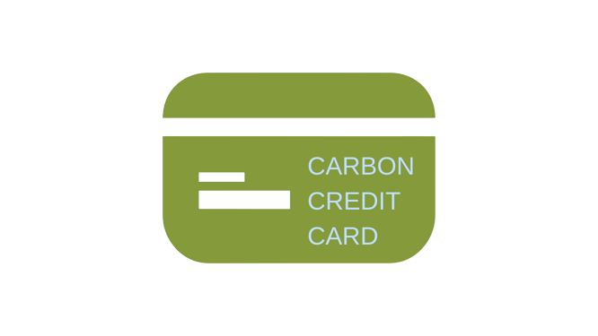
PERSONAL CARBON CREDITS
SOCIAL MEDIA USAGE

Slide 13
FROM THE GOVERNMENT
MONTHLY
PAY AT THE END OF THE MONTH IF OVER-BUDGET
OFFSET TO INCREASE BUDGET
PERSONAL CARBON CREDITS

Slide 14


ENVIRONMENT
DIGITAL WELLBEING

Slide 15
CLIMB WALLS.
NOT EMISSIONS.

Slide 16
CLIMB WALLS.
NOT EMISSIONS.
THE GECKO WAY.

